Slide 1

prediction
Flights price
Ali Albayat – Mozah Alkhaldi

Slide 2

introduction

Slide 3
backstory
New airline company want to operate its flight from different countries of Europe to Riyadh.
Need to analyse the cost of existing airlines.
Look at important factors on flight price.

Slide 4


Data Set & Tools
https://www.almosafer.com/en
Tools
Selenium
BeautifulSoup
SQL
Pandas
Matplotlib
Seaborn
Sklearn
Numpy
Scraping Data from Almosafer.
11 Airport to Riyadh.
First week of December.
3986 rows .
13 column .

Slide 5
Data Cleaning
Convert categorical to numerical DURATION 09h 25m → 565
01
Cheack for NaN and duplicate
02
Drop unwanted columns DESTINATION DATE FLIGHT NUMBER
03
04
Cheack for outliers

Slide 6
DATA ANALYSIS

Slide 7
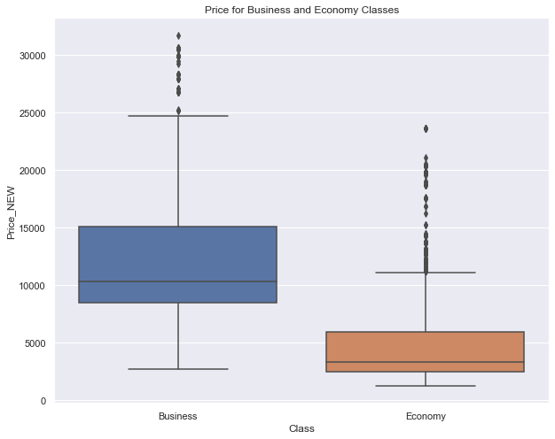
Outliers

Slide 8
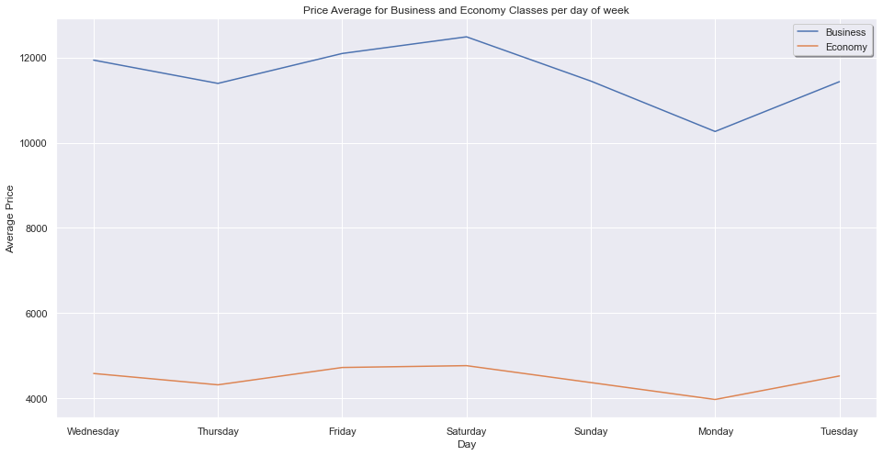
Average Price Per Day

Slide 9
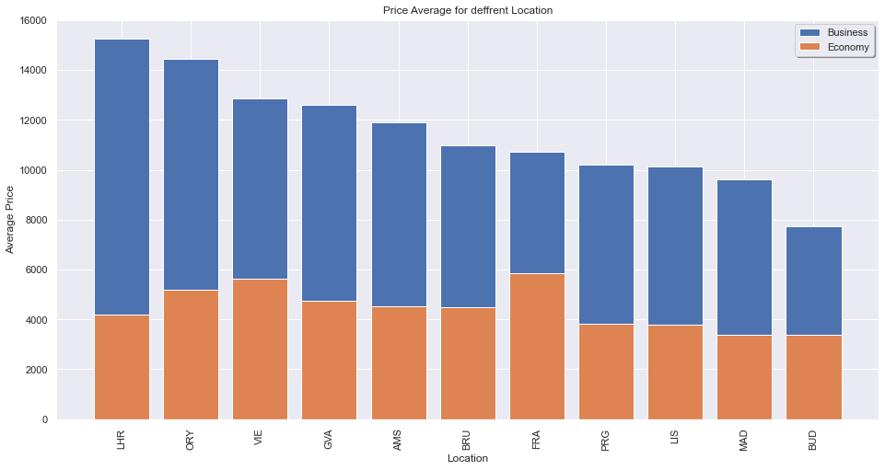
Average Price Per Take-off Location

Slide 10
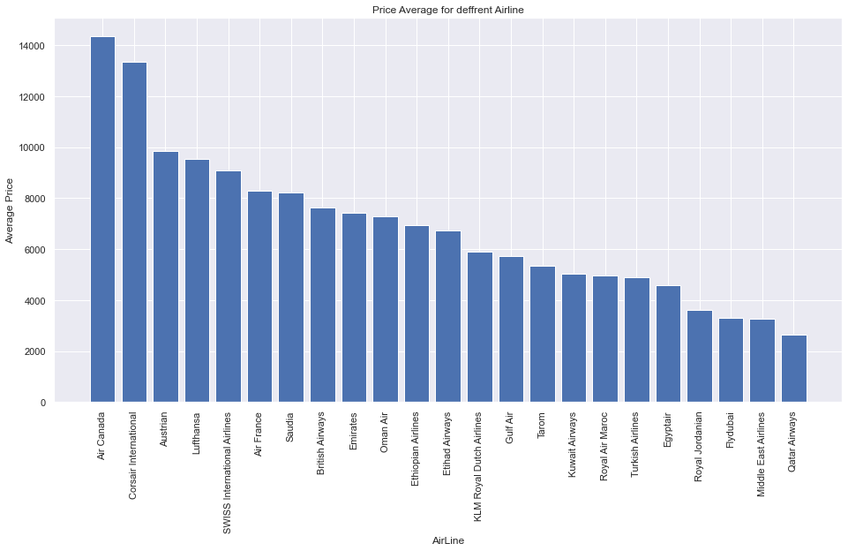
Average Price Per Airline

Slide 11
Regression Models

Slide 12
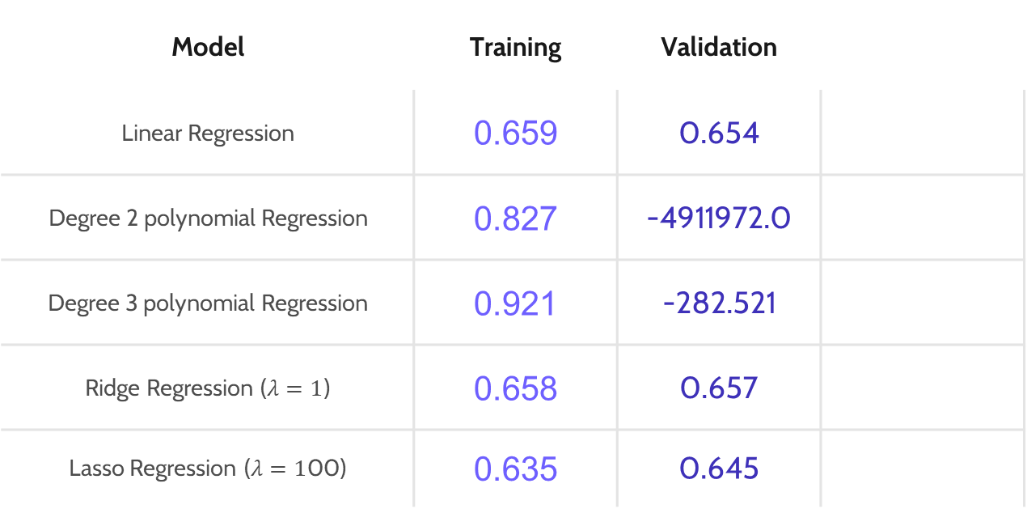
Regression Models
Model | Training | Validation
Linear Regression | 0.659 | 0.654
Degree 2 polynomial Regression | 0.827 | -4911972.0
Degree 3 polynomial Regression | 0.921 | -282.521
Ridge Regression ($λ=1$) | 0.658 | 0.657
Lasso Regression ($λ=1$00) | 0.635 | 0.645
✓
✘
✘
✓
✓

Slide 13
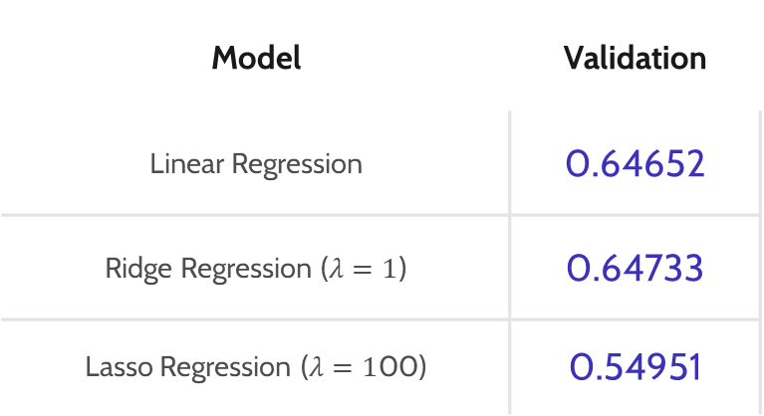
Regression Models
Cross validation
Model | Validation
Linear Regression | 0.64652
Ridge Regression ($λ=1$) | 0.64733
Lasso Regression ($λ=1$00) | 0.54951

Slide 14

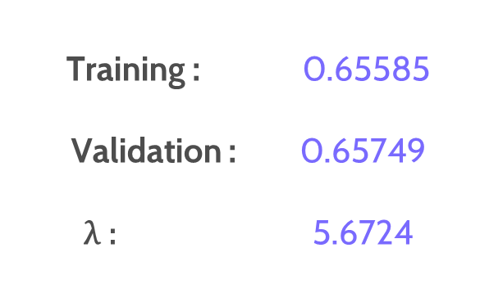
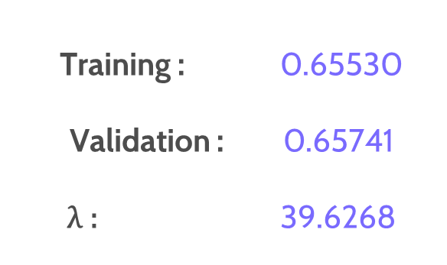
LassoCV
RidgeCV
Training : 0.65585
Validation : 0.65749
$\text{λ}\text{ : }$ 5.6724
Training : 0.65530
Validation : 0.65741
$\text{λ}\text{ : }$ 39.6268
Elastic NET
Validation : 0.65750

Slide 15
Random Forest
Validation : 0.43793
Gradient Boosting
Validation : 0.69350

Slide 16
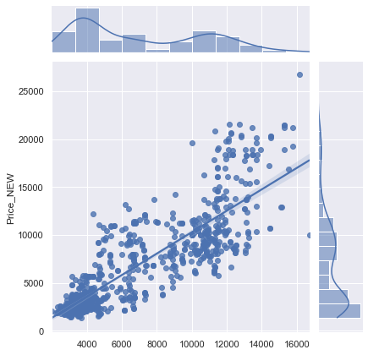
Gradient Boosting
Validation
Predected

Slide 17
Conclusion
Gradient Boosting Test : 0.68298

Slide 18
THANK YOU
FOR LISTINING

